Slide 1
Camp Security Remote Images
By date unenhanced, by date enhanced

Slide 2
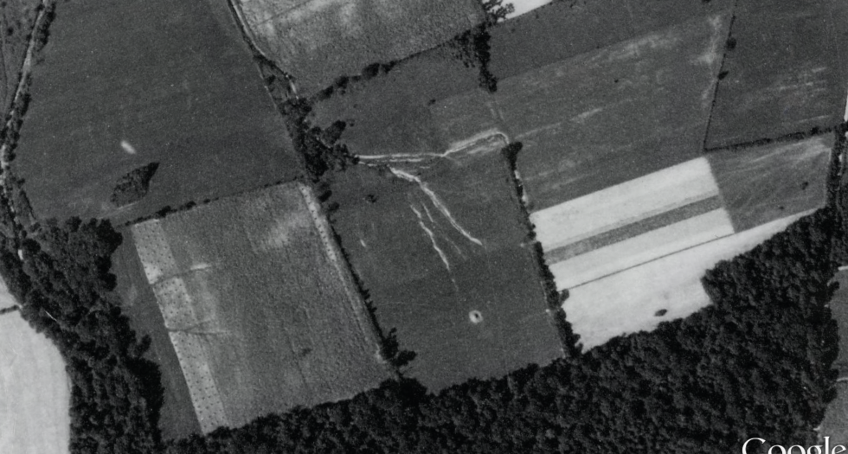
9-1937

Slide 3
9-1957

Slide 4
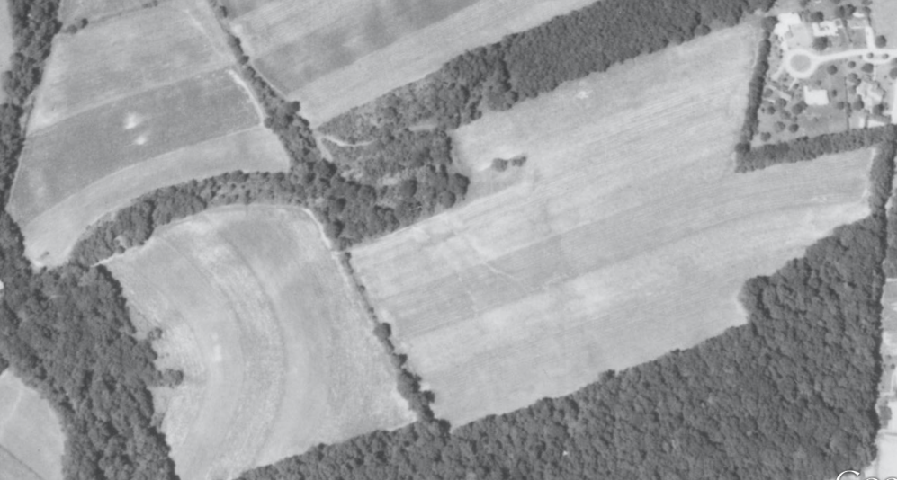
9-1971

Slide 5
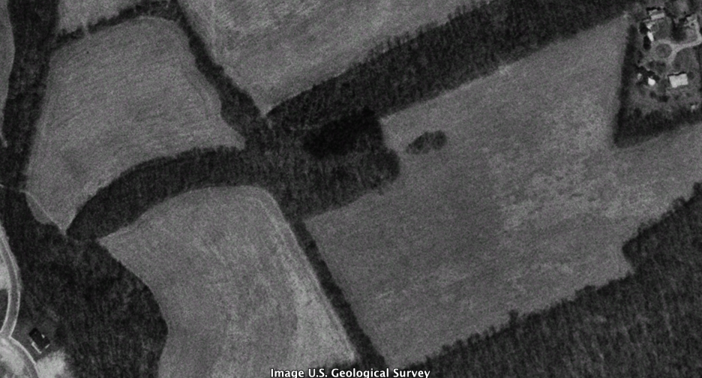
4-1992 enhanced

Slide 6
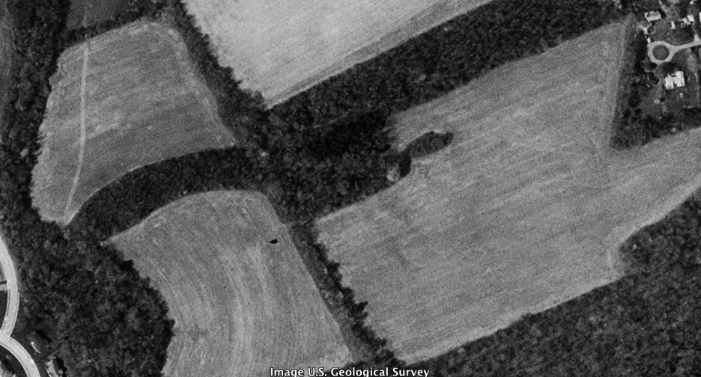
4-1999 enhanced

Slide 7
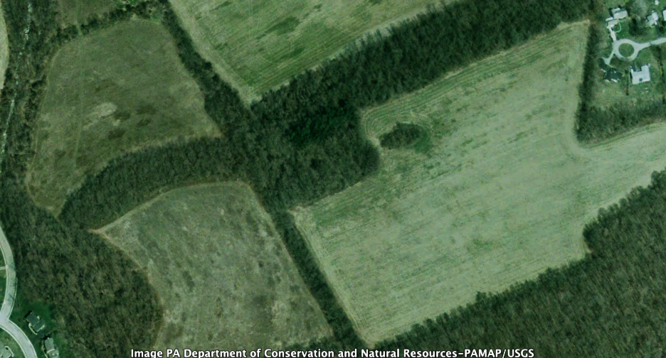
4-2003 enhanced

Slide 8
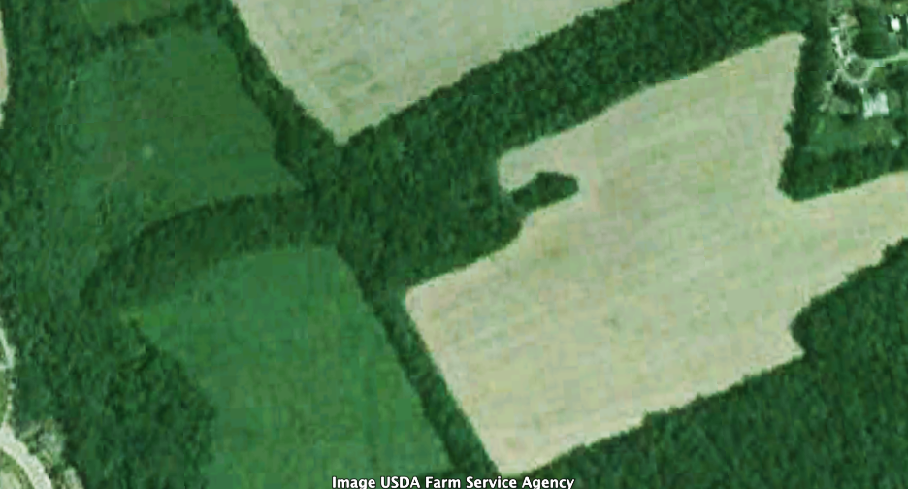
9-2005 enhanced

Slide 9
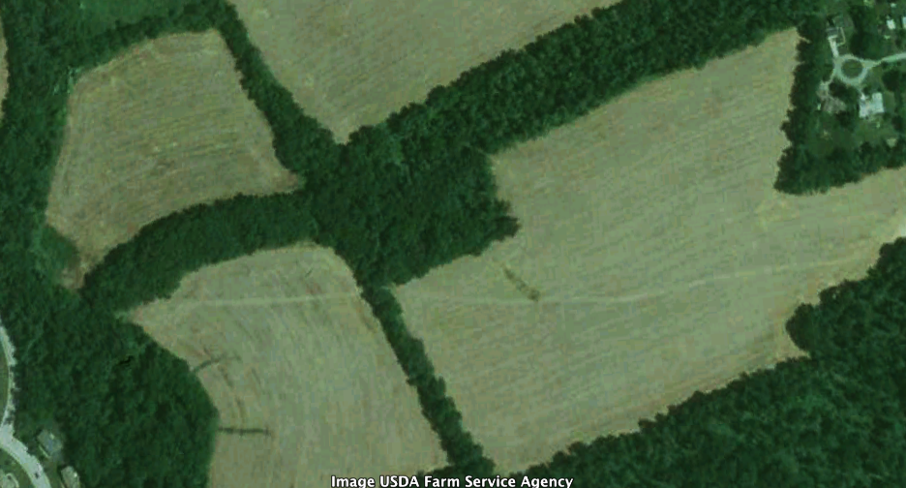
10-2008 enhanced

Slide 10
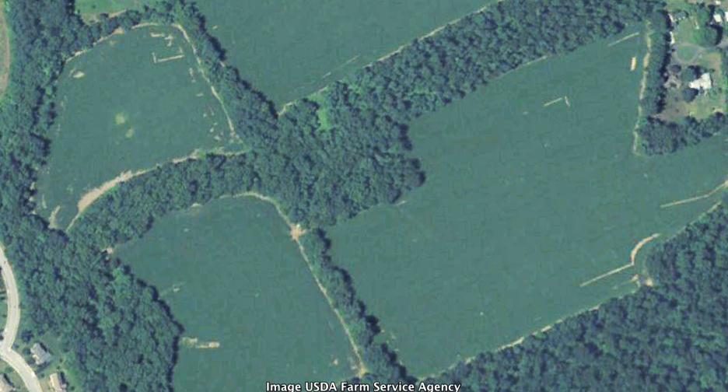
9-2010 enhanced

Slide 11
10-2010 enhanced

Slide 12
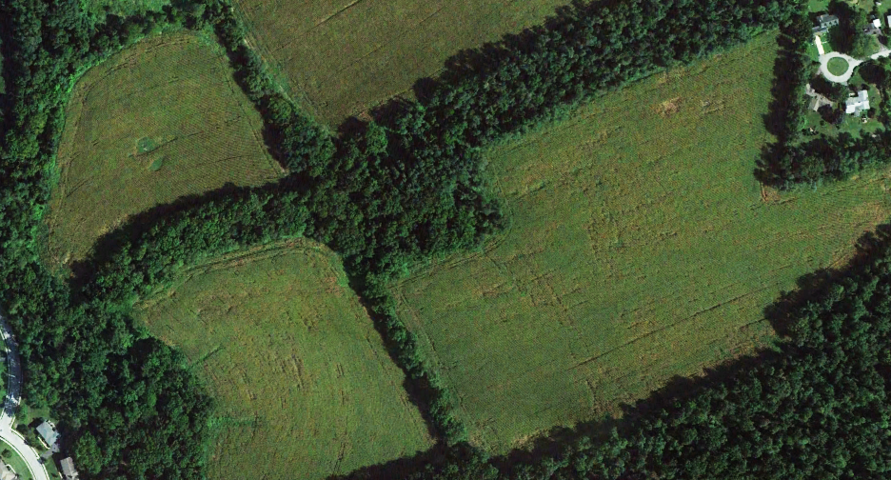
8-2012 enhanced

Slide 13
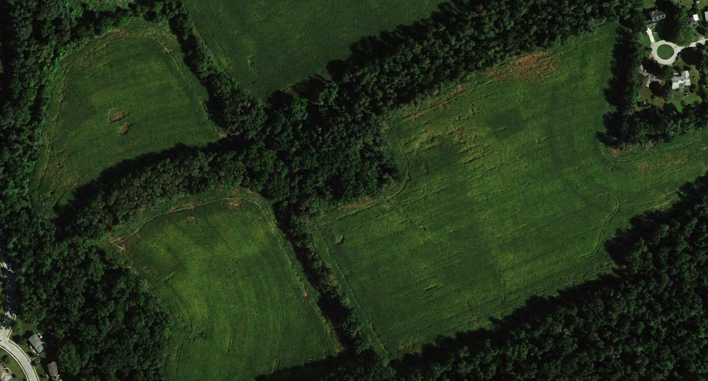
9-2013 enhanced

